Slide 1
Minerals
By: Amanda riley

Slide 2
Types of Minerals
Silicates
Quartz
Feldspars
Ferromagnesian
Non- Silicates
Carbonates
Halides
Natural Elements
Oxides
Sulfates
Sulfites

Slide 3
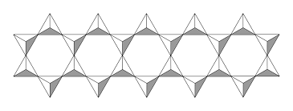
Silicates
a salt in which the anion contains both silicon and oxygen

Slide 4
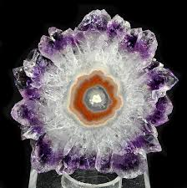
Quartz
quartz

Slide 5
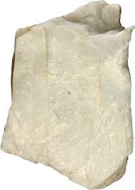
Feldspars
Orthoclase
plagioclase

Slide 6
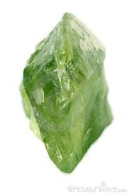
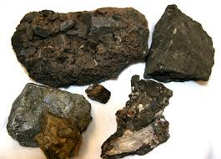
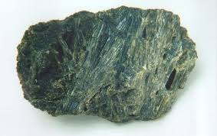
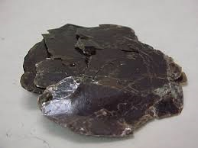
Ferromagnesian
olivine
pyroxenes
pyroxenes
biotite

Slide 7
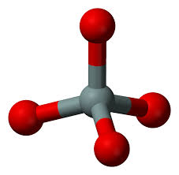
Non- Silicates
lacking silicon
several non-silicate minerals are of great importance

Slide 8
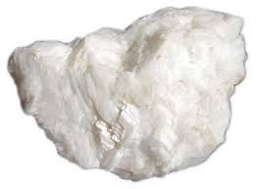
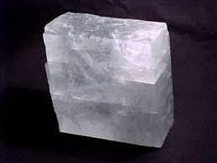
Carbonates
dolomite
calcite

Slide 9
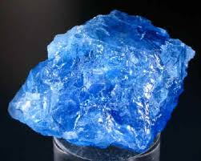
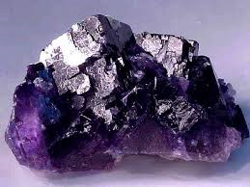
Halides
fluorite
halite

Slide 10
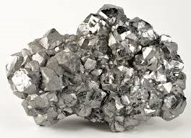
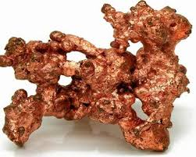
Natural Elements
silver
copper

Slide 11
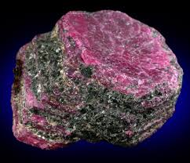
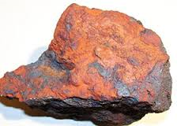
Oxides
hematite
corundum

Slide 12
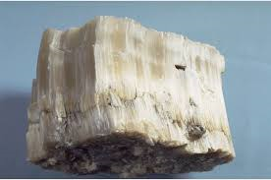
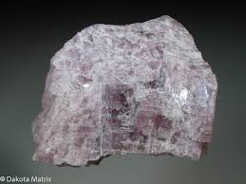
Sulfates
gypsum
anhydrite

Slide 13
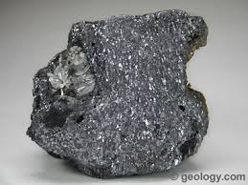
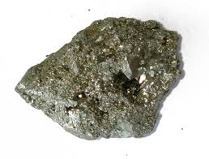
Sulfides
galena
pyrite

Slide 14
You’re welcome ☺ ☺
The end ☺

